Slide 1
Sea Grant Knauss Fellowship
2023
Phone: 240-507-3712
Email: oar.sg.fellows@noaa.gov
https://seagrant.noaa.gov/Knauss

Slide 2
Sea Grant’s Mission
Enhance the practical use and conservation of coastal, marine and Great Lakes resources to create a sustainable economy and environment

Slide 3
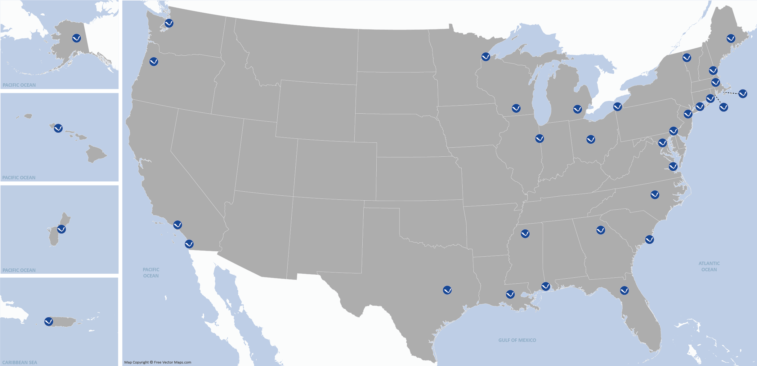
34 University-based Sea Grant Programs
Notes:
Sea Grant is a Public-Private partnership with 34 University based programs. We located in all coastal states, including Puerto Rico, Guam and the Law Center.

Slide 4
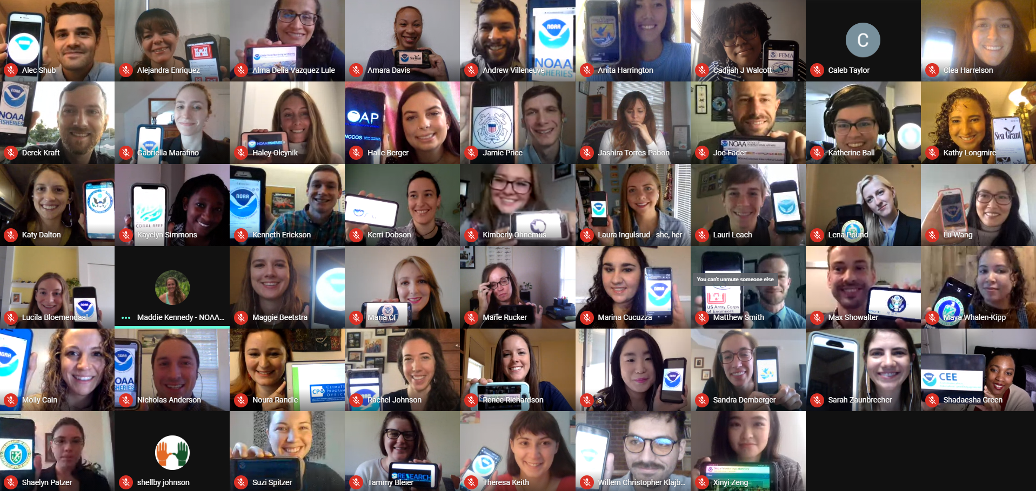
Sea Grant Knauss Fellowship
The Sea Grant Knauss Fellowship provides a unique educational and professional experience to graduate students who have an interest in ocean, coastal and Great Lakes resources and in the national policy decisions affecting those resources.
Class of 2021 Executive Fellows

Slide 5
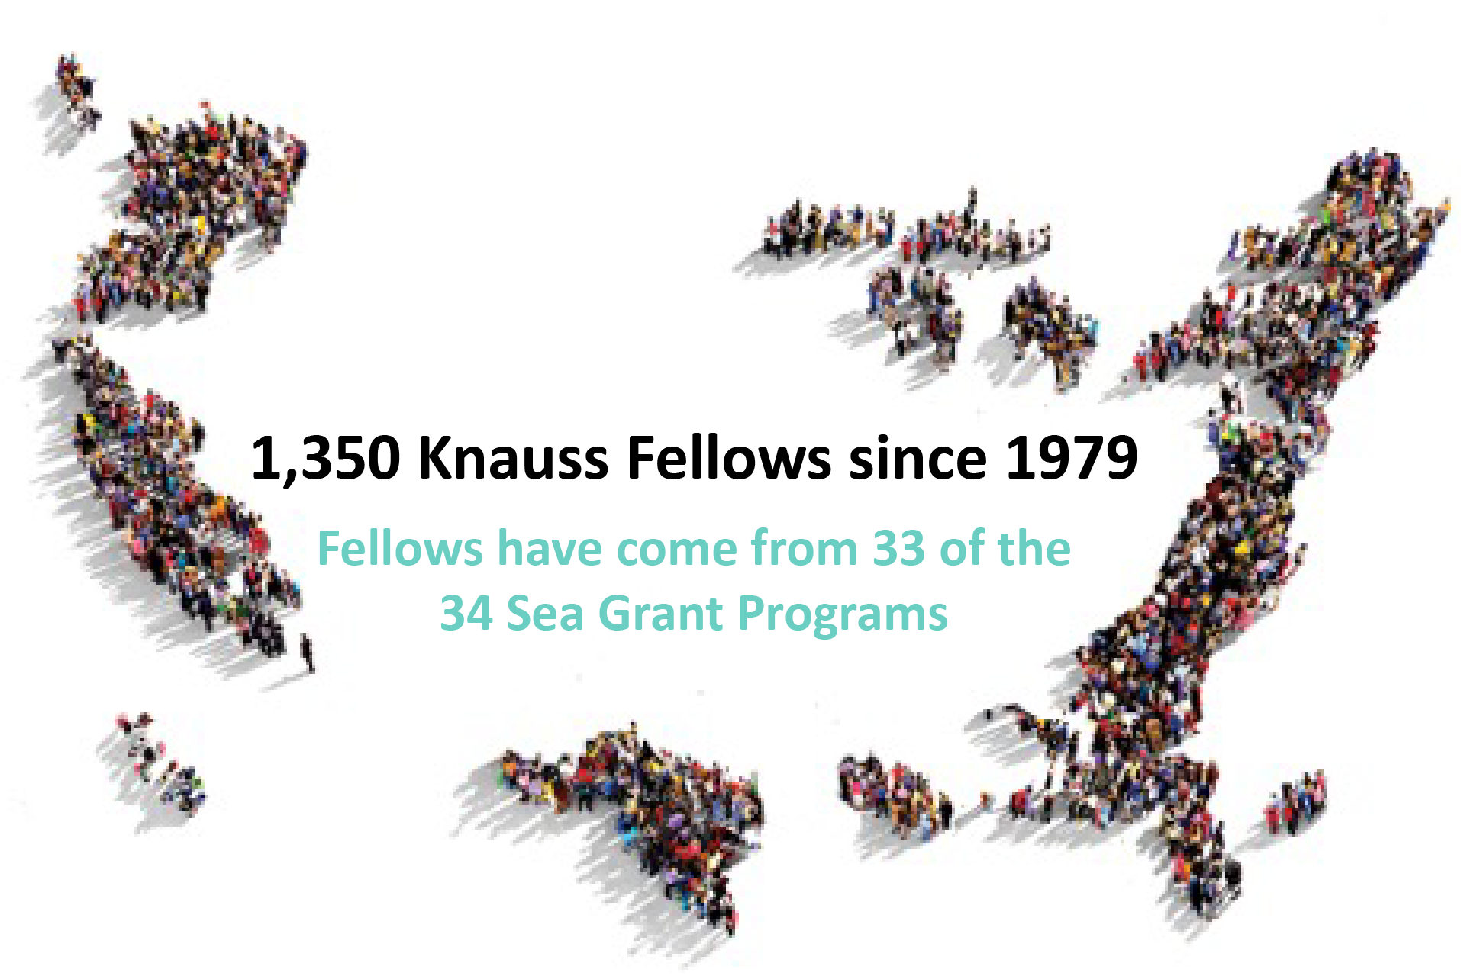
Dean John A. Knauss Marine Policy Fellowship
1,418
Launching illustrious careers, Sea Grant Knauss Fellowships offer direct experience working in the executive and legislative branches on the latest issues in ocean and coastal management, fisheries and research.

Slide 6
The Fellowship Award
Placement in the Washington, DC area in the Legislative or Executive branch for a period of 12 months
$66,500 in salary/stipend (including health benefits)
$5,000 in allowable expenses (relocation, academic tuition, and academic and fellowship related travel expenses)
$2,500 to support travel to the DC region for in person placement process**
$15,000 to support host office travel (*OPTIONAL and subject to the discretion of the host)
Expense |  | Amount
Salary/Stipend |  | $66,500
Professional Development |  | $5,000
Travel | Placement Week | $2,500
 | Host Office Travel* | $15,000
TOTAL |  | $89,000
Notes:
**In person is decided based on the health guidelines.

Slide 7
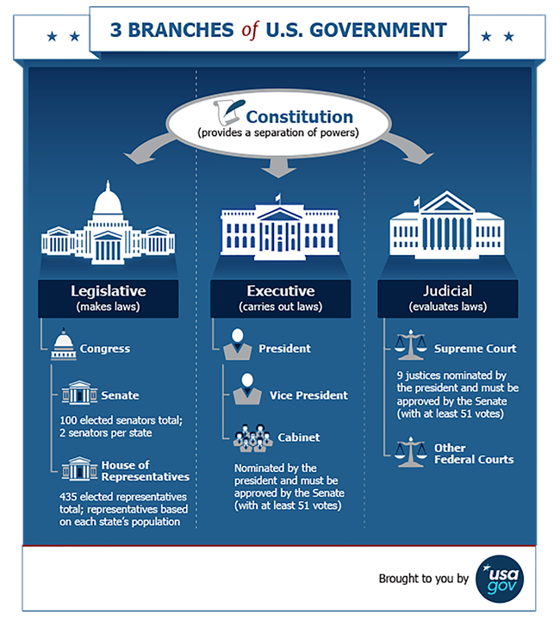

Slide 8
Executive Branch
Work across the Executive Branch of the Government
Many offices have hosted fellows in the past
Frequently work for/with former fellows
May lead specific projects or serve more in a coordination role

Slide 10
Legislative Branch
Many offices have hosted fellows in the past
Frequently work for/with former fellows
Work on hot topics in the office, not always ocean/Great Lakes related

Slide 11
Potential Legislative Hosts
Senate or House of Representatives
Personal Office or Committee
Majority or Minority Offices

Slide 12
General Knauss Fellowship Timeline
Applicants submit packages to their state Sea Grant programs
February
State Sea Grant programs review packages, interview applicants, and submit up to 6 applications to NSGO
March
National reviewers receive applications for merit review
April
Review panel and finalist selection
May
Notification of applicants
June
October/December
Placement Week
Fellowship begins
February

Slide 13
2023 Knauss Fellowship Timeline
Applications due to the State Programs
February 18, 2022 by 5:00 PM Local Time
February
State Sea Grant programs review packages, interview applicants
March
State Sea Grant programs nominate 6 applications to the national competition
April 01, 2022 by 11:59 EDT
April
Review panel and finalist selection
May
Notification of applicants
June
October/January
Placement Week
*These dates are subject to change.
Fellowship begins
February 1, 2023
February

Slide 14
Applicant Eligibility
Any student, regardless of citizenship, is eligible to submit to this opportunity if:
The student is enrolled towards a degree in a graduate program (Masters, PhD or JD) at any point between the onset of the Fall Term (quarter, trimester, semester, etc.) and the state application deadline;
The graduate degree will be awarded through an accredited institution of higher education in the United States or U.S. Territories, and;
The student has an interest in ocean, coastal, and Great Lakes resources and in the national policy decisions affecting those resources.
Application submission is through an application to the Sea Grant program in the state in which the student is earning their degree. If there is no Sea Grant program, a Sea Grant program will be assigned.

Slide 15
Criteria that Affect Eligibility
One year fellowship will take place in the National Capital region (DMV). Applicants must be prepared to relocate to the DMV
Applicants must be able to pass a federal background security check (includes arrest record, questions on drug use, and a possible review of social media presence)
Prior contact/arrangements made with possible host offices before the start of the placement week will be cause for immediate disqualification from the process.
Applicants that have been accepted as National Finalists and/or become fellows are not eligible to apply again without the written permission of the NSGO Fellowships Manager, which will only be granted in response to exceptional life events. A National Finalists is defined as an applicant who goes through the review process and is selected at the national level for the fellowship program. Applicants are considered finalists until they are placed into a host office during the placement process.

Slide 16
Forign Nationalist Details
Foreign nationals are eligible for both the Executive and Legislative cohort
Non-U.S. Citizens are responsible for obtaining the appropriate Visa to allow them to work in the DMV
Visa Types (most common)
Student--F1 Visa
Graduated--Optional Practical Training (OPT) Extension
This fellowship is open to all eligible students regardless of nationality, a significant number of participating Federal host offices are unable to accept foreign nationals as Fellows. This may reduce the number of placement opportunities available to foreign nationals.

Slide 17
The Application Package
Project Narrative
TO BE SUBMITTED BY THE STUDENT
(1) Curriculum vitae
(2) Personal Education and Career Development Response | Section Once: Icebreaker
 | Section Two: Career Path and Objectives
 | Section Three: Career Path Experience
(3) Relevant Coursework and Future Year Plans
(4) Letters of Recommendation
(5) Transcripts
(6) (if applicable) Out of State Letter
TO BE SUBMITTED BY THE PROGRAM
(7) Director Letter

Slide 18
(1) Curriculum Vitae
NOT to exceed TWO pages
The student should not include personal contact information or web links to external resources (eg. Linkedin, articles, blogs, ect.).
If included, programs should redact excess materials prior to submission to grants.gov

Slide 19
(2) Personal Education and Career Development Response
The student should emphasize their abilities and expectations of the fellowship experience in terms of their career development.
Each section and subsequent subsection should be answered separately.
The entire personal education and career development section should not exceed 1,500 words total; suggested word counts will be included with each subsection below.
Section headers will count as part of the overall word count.
The student should not include personal contact information or web links to external resources (e.g., LinkedIn, articles, blogs, etc.). If included, programs should redact prior to submission.

Slide 20
(2) Personal Education and Career Development Response
Section One: ICEBREAKER
The suggested word count is 25 words for this section.
Questions:
(suggest 20 words) The student should use one sentence to describe themselves.
(5 words MAX--this is the only question with a strict word count): The student should list five adjectives that someone with a close personal connection (coworker, supervisor, etc.) would use to describe them.

Slide 21
(2) Personal Education and Career Development Response
Section Two: CAREER PATH AND OBJECTIVES
This section can be completed as one continuous statement or as separate responses. The suggested word count is 700 words for this section.
Questions:
(Suggest 250 words) The student should discuss any experience(s) (researcher or otherwise) that support or relate to the mission of the National Sea Grant College Program or the state Sea Grant program (the student does not have to have had a direct connection to Sea Grant). The student should emphasize (if relevant) any experience with extending and distilling science for non-scientific audiences.
(Suggest 250 words) The student should discuss their interest in the Knauss Fellowship with a specific focus on how the Knauss Fellowship supports the student’s career pathway. The student should focus on how the Knauss Program would further support their development as a professional.
(Suggest 200 words) The student should discuss the transferable skills (skills that can be applied across a variety of disciplines) that they would bring to the Knauss Fellowship. In this response, students should highlight experiences from their personal, professional and academic background.

Slide 22
(2) Personal Education and Career Development Response
Section Three: CAREER PATH EXPERIENCE
The suggested word count is 700 words for this section.
Questions:
(Suggest 300 words) Sea Grant values the principles of equity, diversity, inclusion, justice and accessibility. The student should discuss (1) how they have collaborated or engaged with diverse community members and/or interested partners and/or (2) how they would be an ambassador for these principles throughout the Knauss program.
(Suggest 400 words) The student should discuss a situation in which they overcame a challenge (e.g. within a community or institution, personally, professionally, etc.) specifically as it relates to how they took a leadership role. The student should also consider including a reflection on what they learned from this experience.

Slide 23
(3) Relevant Coursework and Future Year Plans
NOT to exceed ONE page single spaced
The student should discuss any relevant coursework and their future year activities.
Relevant Coursework: The student may discuss any completed or in progress classes that they deem relevant to their success in the Knauss Fellowship Program.
Future year activities: The student should include a listing of classes and/or plans for spring 2022, summer 2022, and fall 2022.

Slide 24
(4) Letters of Recommendation
Two letters of recommendation from individuals who have worked with the student, including at least one from a faculty member with knowledge of the student’s academic and research (when applicable) performance.
Letters should not exceed two pages single spaced. (each)
These letters should discuss the following attributes of the student: self-motivation, response to setbacks, skills and involvement in teamwork, collaborative leadership skills, willingness to learn a new skill or topic, academic and performance and potential. Additionally, the letters should speak to anything else the review panel should know about the strengths that the student will bring to the fellowship.
The letters should not include personal contact information or web links to external resources (e.g., LinkedIn, articles, blogs, etc.).
If included, programs should redact prior to submission.
Any letters beyond the two letters of recommendation and the eligible Sea Grant director’s letter will be disregarded by the selection panel. Letters of endorsement from members of Congress, friends, or relatives will not be accepted.

Slide 25
(5) Transcripts
Clear digital or scanned copies of all undergraduate and graduate student transcripts (unofficial are acceptable).

Slide 26
(6) Out of State Letter*
If applicable, for applicants in a state or territory not served by an eligible Sea Grant program, but applying through an eligible Sea Grant program, a written statement from the Sea Grant Knauss Fellowship Program Manager referring the applicant to the most appropriate eligible Sea Grant program must be included as part of that applicant's application package to the Sea Grant program.

Slide 27
(1) Director Letter
A signed letter of recommendation from the state Sea Grant director, which is built from an interview with the applicant. As part of that interview and subsequent letter, the director shall:
demonstrate why the student is a good fit for the Knauss program;
highlight the skills the student emphasizes in the interview;
explain any gaps in the CV or personal education and career development response or anything that the student feels they were unable to include in the application that they feel is important for the review panel to know; and
advocate for why this student belongs in the Knauss Fellowship Program.
Letter should not exceed two pages single spaced.

Slide 28
Evaluation Criteria
Evaluation Criteria
Evaluation Criteria | Section |  | Points
Relevant Experience | Curriculum vitae |  | 10 Points
 | Personal Education and Career Development Response | Section Once: Icebreaker | 5 Points
 |  | Section Two: Career Path and Objectives | 25 Points
 |  | Section Three: Career Path Experience | 25 Points
 | Relevant Coursework and Future Year Plans |  | 10 Points
Recommendations and/or endorsements | Letters of Recommendation |  | 5 Points
 | Director Letter |  | 10 Points
Overall Application Cohesion | All aspects of the application materials (CV, Personal education and career development responses, relevant coursework and future year plans, letters of recommendation and directors letter |  | 10 Points

Slide 29
(1) Relevant Experience
75 Points TOTAL
Relevant experience related to diversity of education; extra-curricular activities; and interpersonal, written and oral communication skills and other applicable competencies.
For the Knauss Fellowship Program, this includes the curriculum vitae, personal education and career development response, and Relevant Coursework and Future Year Plans which will be reviewed as follows.

Slide 30
(1) Curriculum Vitae
10 POINTS
The point scale is as follows:
The CV is unclear and does not adequately address the expectations outlined below (0-3 points);
the CV adequately addresses expectations outlined below (4-6 points);
the CV exceeds expectations outlined below (7-10 points).
Review Criteria
The student has employment, volunteer, or extracurricular activities in academic, applied, research, administration, outreach, or policy positions;
The education and experience (personal and professional) in the student’s area of expertise are appropriate to the career stage;
The student demonstrates academic, professional or personal experiences that are relevant and applicable to serving the American people;
The student's experiences show prior leadership roles relevant to their career stage (e.g., student government, faculty committees, advisory committees, professional societies, community initiatives, etc.).
(1) Relevant Experience

Slide 31
(2) Personal Education and Career Development Response
Section One: ICEBREAKER
5 POINTS
The point scale is as follows:
The icebreaker does not adequately address expectations outlined below (0-1 points);
the icebreaker adequately addresses expectations outlined below (2-3 points);
the icebreaker exceeds expectations outlined below (4-5 points).
Review Criteria:
The student demonstrates creative thinking and a willingness to think outside the box.
(1) Relevant Experience

Slide 32
(2) Personal Education and Career Development Response
Section Two: CAREER PATH AND OBJECTIVES
25 POINTS
The point scale is as follows:
The career path and objectives does not adequately address the expectations outlined below (0-8 points);
the career path and objectives adequately addresses expectations outlined below (9-18 points);
the career path and objectives exceeds expectations outlined below (19-25 points).
Evaluation Criteria:
The career path and objectives are specific, direct, and concise while discussing what the student would bring to and gain from the Knauss fellowship;
The student clearly articulates their career or professional goal;
The career path and objectives demonstrates the student’s diverse personal and professional background;
The student demonstrates creative thinking, analytical skill, and/or indicates their capacity and willingness to make connections between science and broader economic, social, and political issues;
The student demonstrates their ability to convey scientific knowledge in broader, non-scientific contexts;
The career path and objectives align with the broader mission of the Sea Grant program and NOAA.
(1) Relevant Experience

Slide 33
(2) Personal Education and Career Development Response
Section Three: CAREER PATH EXPERIENCE
25 POINTS
The point scale is as follows:
The career path experience does not adequately address the expectations outlined below (0-8 points);
the career path experiences adequately addresses expectations outlined below (9-18 points);
the career path experiences exceeds expectations outlined below (19-25 points).
Review Criteria:
The student has shown interest in working with diverse collaborators, community members and/or interested partners;
The student demonstrates an interest in or commitment to the Sea Grant values of Diversity, Equity, Inclusion, Justice and Accessibility;
The student’s experience demonstrates a commitment to apply expertise to serve science and society;
The student demonstrates creativity and willingness to navigate a challenging situation;
The student demonstrates leadership and problem solving initiative.
(1) Relevant Experience

Slide 34
(3) Relevant Coursework and Future Year Plans
10 POINTS
The point scale is as follows:
the relevant coursework and future year plans are unclear and do not adequately address the expectation outlined below (0-3 points);
the relevant coursework and future year plans adequately addresses expectations outlined below (4-6 points);
the relevant coursework and future year plans exceeds expectations outlined below (7-10 points).
Review Criteria:
The student has employment, volunteer, or extracurricular activities in academic, applied, research, administration, outreach, or policy positions;
The education and experience (personal or professional) in the student’s area of expertise are appropriate to the career stage;
The student demonstrates work/life experiences that are relevant and applicable to serving the American people;
The student’s experiences show prior leadership roles relevant to their career stage (e.g., student government, faculty committees, advisory committees, professional societies, community initiatives, etc.).
(1) Relevant Experience

Slide 35
(2) Recommendations and/or endorsements of the student
15 Points TOTAL
For the Knauss Fellowship program the endorsements and content of the letter from the student's Sea Grant director, academic reference, and the second letter of recommendation are reviewed as follows.
(2) Recommendations

Slide 36
(4) Letters of Recommendation
5 POINTS
The point scale is as follows:
the letters of recommendation do not adequately address the expectations outlined below (0-1 points);
the letters of recommendation adequately address expectations outlined below (2-3 points);
the letters of recommendation exceed expectations outlined below (4-5 points).
Review Criteria:
The letter writers demonstrate knowledge of the student and their abilities;
The letter writers speak to the leadership potential, confidence, maturity, and self-direction of the student;
The letter writers provide evidence of the student’s willingness and flexibility to tackle issues beyond their area of expertise and an openness and capacity to expand experiences;
The letter writers provide evidence of the student’s ability to convey scientific knowledge in broader, non-scientific contexts.
(2) Recommendations

Slide 37
(1) Director Letter
10 POINTS
The point scale is as follows:
the director’s letter is unclear and does not adequately address the expectation outlined below (0-3 points);
the director’s letter adequately addresses expectations outlined below (4-6 points);
the director’s letter exceeds expectations outlined below (7-10 points).
Review Criteria:
The director’s letter demonstrates how the student fits with the Knauss Program, including any discussion of why the student belongs in the Knauss Program;
Highlights the skills (academic, professional or personal) that the student would bring to the Knauss program;
Elaborates on information not specifically addressed by the student in their application package.
(2) Recommendations

Slide 38
(3) Overall Application Cohesion
10 POINTS
For the Knauss Fellowship program consider all aspects of the application materials (CV, Personal education and career development responses, Letters of Recommendation, Directors Letter).
The point scale is as follows:
the application is unclear and does not adequately address the expectation outlined below (0-3 points);
the application adequately addresses expectations outlined below (4-6 points);
the application exceeds expectations outlined below (7-10 points).
Review Criteria
The application materials complement each other;
The student brings a diverse perspective to the program;
The application materials provide a clear picture of what the student would gain from receiving the Knauss Fellowship;
The application materials provide a clear picture of what the student would bring to the Knauss Fellowship.
(2) Recommendations

Slide 39
(5) Transcripts
NOT PART OF THE REVIEW CRITERIA

Slide 40
(6) Out of State Letter*
NOT PART OF THE REVIEW CRITERIA

Slide 41
Application Tips
Reach out to the appropriate Sea Grant Program Early! Ask them for tips on the application process and to be connected to an alumni that may be able to answer your questions.
Re-read: The application requirements and your application materials.
Letters of Rec: Prep your letter writers about the opportunity. Give them time to provide meaningful comment about you.
Start early: Collecting all the pieces can take time.
Stay true to yourself, this is your application, let your character and goals be the focus!
PROOFREAD

Slide 42
Sea Grant Knauss Fellowship
Phone: 240-507-3712
Email: oar.sg.fellows@noaa.gov
https://seagrant.noaa.gov/Knauss

Slide 43
Extra Slides

Slide 44
Application Materials: CV
Curriculum Vitae
Recommended Length | Two Page (MAX)
Notes | The student should not include personal contact information or web links to external resources (e.g., LinkedIn, articles, blogs, etc.).
Pro Tip | Utilize formating (bold, italics, indentations) to help provide a clear and concise CV.
Points | 10 Points
Point Scale | -the CV is unclear and does not adequately address the expectations outlined below (0-3 points); -the CV adequately addresses expectations outlined below (4-6 points); -the CV exceeds expectations outlined below (7-10 points).
Review Criteria | -The student has employment, volunteer, or extracurricular activities in academic, applied, research, administration, outreach, or policy positions; -The education and experience (personal and professional) in the student’s area of expertise are appropriate to the career stage; -The student demonstrates academic, professional or personal experiences that are relevant and applicable to serving the American people; -The student’s experiences show prior leadership roles relevant to their career stage (e.g., student government, faculty committees, advisory committees, professional societies, community initiatives, etc.).

Slide 45
Application Materials: Personal Education and Career Development Response
Overall
Summary Table: Personal Education and Career Development Response
Recommended Length | The entirety of the Personal Education and Career Development Responses should not exceed 1,500 words. Section headers will count as part of the overall word count.
Pro Tip | -Read each section carefully and make sure to address the full question being asked. -Do not repeat your CV, rather expand on it.
Total Points | 55 Points

Slide 46
Application Materials: Personal Education and Career Development Response
SECTION ONE: ICE BREAKER
Section One: Ice Breaker
 | Question 1 | Question 2
Recommended Length | 20 Words | 5 Words MAX (strict word count)
Questions | The student should use one sentence to describe themselves. | The student should list five adjectives that someone with a close personal connection (coworker, supervisor, etc.) would use to describe them.
Pro Tip | Think outside the box and be creative! | Actually ask someone who you trust to give you a few words.
Points | 5 Points
Point Scale | -the icebreaker does not adequately address expectations outlined below (0-1 points); -the icebreaker adequately addresses expectations outlined below (2-3 points); -the icebreaker exceeds expectations outlined below (4-5 points).
Review Criteria | The student demonstrates creative thinking and a willingness to think outside the box.

Slide 47
Application Materials: Personal Education and Career Development Response
SECTION TWO: CAREER PATH AND OBJECTIVES
Section Two: Career Path and Objectives
NOTE: This section may be written as one long pros OR as individual questions.
 | Question 1 | Question 2 | Question 3
Recommended Length | 250 Words | 250 Words | 200 Words
Questions | The student should discuss any experience(s) (researcher or otherwise) that support or relate to the mission of the National Sea Grant College Program or the state Sea Grant program (the student does not have to have had a direct connection to Sea Grant). The student should emphasize (if relevant) any experience with extending and distilling science for non-scientific audiences. | The student should discuss their interest in the Knauss Fellowship with a specific focus on how the Knauss Fellowship supports the student’s career pathway. The student should focus on how the Knauss Program would further support their development as a professional. | The student should discuss the transferable skills (skills that can be applied across a variety of disciplines) that they would bring to the Knauss Fellowship. In this response, students should highlight experiences from their personal, professional and academic background.
Pro Tip | Review the mission of both the National Sea Grant Program and the state through which you are applying. | Be specific about why Knauss. If you are unsure, explore how Knauss will help define or guide your career. | Tell us what you would bring to Knauss.
Points | 25 Points
Point Scale | -the career path and objectives does not adequately address the expectations outlined below (0-8 points); -the career path and objectives adequately addresses expectations outlined below (9-18 points); -the career path and objectives exceeds expectations outlined below (19-25 points).

Slide 48
Application Materials: Personal Education and Career Development Response
SECTION THREE: CAREER PATH EXPERIENCE
Section Three: Career Path Experience
 | Question 1 | Question 2
Recommended Length | 300 Words | 400 Words
Questions | Sea Grant values the principles of equity, diversity, inclusion, justice and accessibility. The student should discuss (1) how they have collaborated or engaged with diverse community members and/or interested partners and/or (2) how they would be an ambassador for these principles throughout the Knauss program. | The student should discuss a situation in which they overcame a challenge (e.g. within a community or institution, personally, professionally, etc.) specifically as it relates to how they took a leadership role. The student should also consider including a reflection on what they learned from this experience.
Pro Tip | Think about what the principles of DEIJ mean to you and how those principles have guided or will guide you. | Make sure to tell a story (no need for specificity details like names or institutions).
Points | 25 Points
Point Scale | -the career path experience does not adequately address the expectations outlined below (0-8 points); -the career path experiences adequately addresses expectations outlined below (9-18 points); -the career path experiences exceeds expectations outlined below (19-25 points).
Review Criteria | -The student has shown interest in working with diverse collaborators, community members and/or interested partners; -The student demonstrates and interest in or commitment to the Sea Grant values of Diversity, Equity, Inclusion, Justice and Accessibility; -The student’s experience demonstrates a commitment to apply expertise to serve science and society; -The student demonstrates creativity and willingness to navigate a challenging situation; -The student demonstrates leadership and problem solving initiative.

Slide 49
Application Materials: RELEVANT COURSEWORK AND FUTURE YEAR PLANS
Relevant Coursework and Future Year Plans
Recommended Length | One Page single spaced (MAX)
Section Description | The student should discuss any relevant coursework and their future year activities. Relevant Coursework: The student may discuss any completed or in progress classes that they deem relevant to their success in the Knauss Program. Future year activities: The student should include a listing of classes and/or plans for spring 2022, summer 2022, and fall 2022.
Pro Tip | Provide explanation for why a class you have take or activity in your future, applies to or supports the Knauss program.
Points | 10 Points
Point Scale | -the relevant coursework and future year plans are unclear and do not adequately address the expectation outlined below (0-3 points); -the relevant coursework and future year plans adequately addresses expectations outlined below (4-6 points); -the relevant coursework and future year plans exceeds expectations outlined below (7-10 points).
Review Criteria | -The student has employment, volunteer, or extracurricular activities in academic, applied, research, administration, outreach, or policy positions; -The education and experience (personal or professional) in the student’s area of expertise are appropriate to the career stage; -The student demonstrates work/life experiences that are relevant and applicable to serving the American people; -The student’s experiences show prior leadership roles relevant to their career stage (e.g., student government, faculty committees, advisory committees, professional societies, community initiatives, etc.).

Slide 50
Application Materials: LETTERS OF RECOMMENDATION
TWO LETTERS FROM PEOPLE WHO KNOW THE STUDENT WELL
Letters of Recommendation (submitted by STUDENT)
Recommended Length | Two Pages single spaced (per letter) (MAX)
Section Description | Letters from individuals who have worked with the student, including at least one from a faculty member with knowledge of the student’s academic and research (when applicable) performance. These letters should discuss the following attributes of the student: self-motivation, response to setbacks, skills and involvement in teamwork, collaborative leadership skills, willingness to learn a new skill or topic, academic and performance and potential. Additionally, the letters should speak to anything else the review panel should know about the strengths that the student will bring to the fellowship.
Pro Tip | Schedule an appointment or meeting with your letter writers well in advance. Discuss the program to which you are applying, the selection criteria, and highlight your most relevant professional experiences. Make this process as easy for the writers as possible!
Points | 5 Points
Point Scale | -the letters of recommendation do not adequately address the expectations outlined below (0-1 points); -the letters of recommendation adequately address expectations outlined below (2-3 points); -the letters of recommendation exceed expectations outlined below (4-5 points).
Review Criteria | -The letter writers demonstrate knowledge of the student and their abilities; -The letter writers speak to the leadership potential, confidence, maturity, and self-direction of the student; -The letter writers provide evidence of the student’s willingness and flexibility to tackle issues beyond their area of expertise and an openness and capacity to expand experiences; -The letter writers provide evidence of the student’s ability to convey scientific knowledge in broader, non-scientific contexts

Slide 51
Application Materials: LETTERS OF RECOMMENDATION
DIRECTOR’S LETTER
Sea Grant Director's Letter
Recommended Length | Two Pages single spaced (MAX)
Section Description | (a) demonstrate why the student is a good fit for the Knauss program; (b) highlight the skills the student emphasizes in the interview; (c) explain any gaps in the CV or personal education and career development response or anything that the student feels they were unable to include in the application that they feel is important for the review panel to know; and (d) advocate for why this student belongs in the Knauss Program.
Pro Tip | Be true to yourself in your interview with the director.
Points | 10 Points
Point Scale | -the director’s letter is unclear and does not adequately address the expectation outlined below (0-3 points); -the director’s letter adequately addresses expectations outlined below (4-6 points); -the director’s letter exceeds expectations outlined below (7-10 points).
Review Criteria | -The director’s letter demonstrates how the student fits with the Knauss Program, including any discussion of why the student belongs in the Knauss Program; -Highlights the skills (academic, professional or personal) that the student would bring to the Knauss program; -Elaborates on information not specifically addressed by the student in their application package

